Slide 1
Modelica language – a promising tool for publishing and sharing of biomedical models
Jiří Kofránek, Filip Ježek, Marek Mateják

Slide 2
The origin - a web of physiological regulations
A famous article by Arthur Guyton (1972)
started an era of integrative physiology
A new way how to view physiology
quantification
formalization

Slide 3
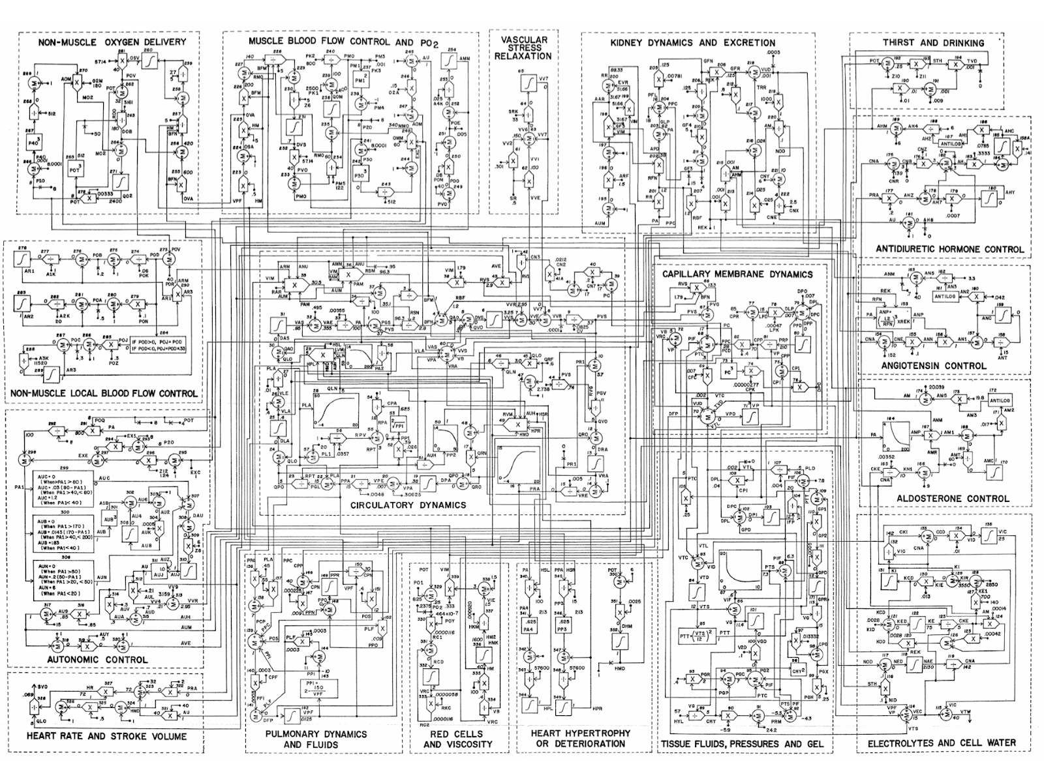

Slide 4
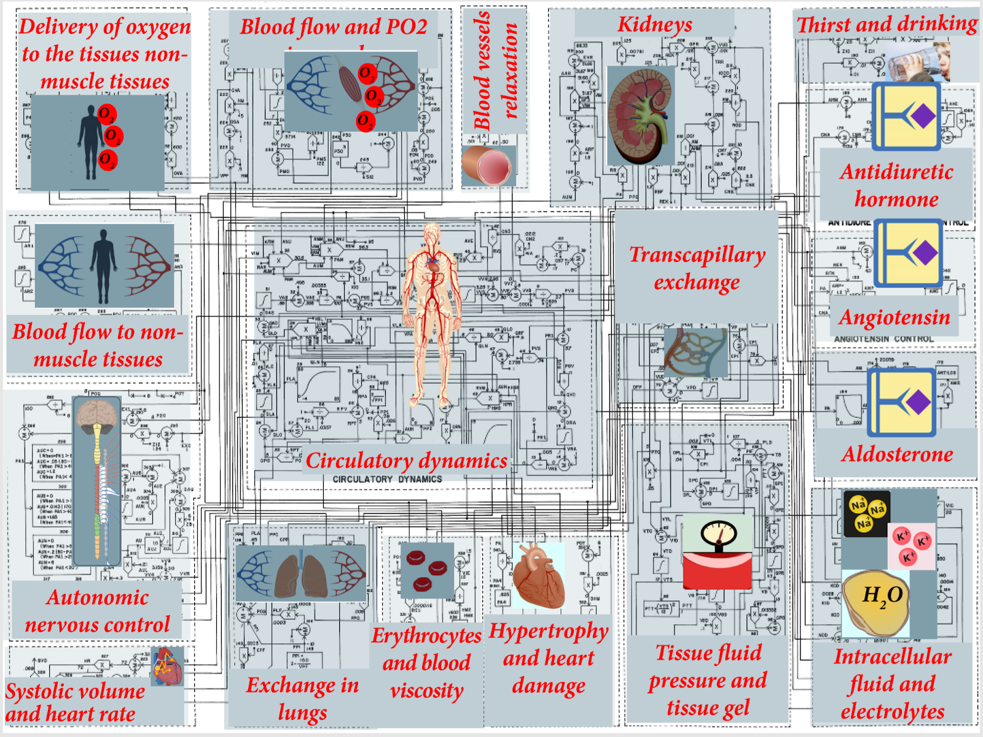

Slide 5
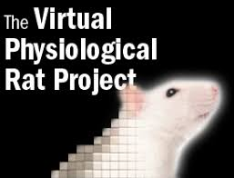


Formalization of physiological relations
Physiome project
in EU: IUPS Physiome
In USA: e.g. the Virtual RAT
… lot of research attention

Slide 6
Model re-implementation: our experience
Reproducibility - the main approach in exploring the nature
often violated though
around 80 % of models implemented based on a description contain some error, that prevents from using the model correctly

Slide 7
Model re-implementation: our experience
minor mistake of the authors (e.g. index, value unit etc..) -> unreproducible
versioning problem
published version is older than the obtained
The peer-review problem
not reimplemented by the reviewers
not even run by the reviewers

Slide 8
Model presentation in scientific publications
graphical diagram is not enough
equations are not enough
too complex to show all equations, parameters and initial values

Slide 9
Model presentation in scientific publications
Therefore, a paper MUST be accompanied with a digital appendix
model structure
parameters
starting values

Slide 10
Modeling paper’s supplement
preferably with a source code in a common, formal, programming language
Versioning
field- or institution- specific open access repositories
general open-access repository, e.g. Zenodo, OpenDepot, or GitHub.
This is becoming a standard, especially in a number of open-access journals

Slide 11
Biomedical models repositories
Efforts of the Physiome project
often dedicated to a specialized language of its own
open languages and free tools

Slide 12
Biomedical model tools
Virtual Cell project (http://vcell.org) - visualization and simulation of the cell metabolism and cell signal paths
client-server environment
"Bio Tapestry" (http://www.biotapestry.org) - modeling regulatory gene networks
JSim (http://www.physiome.org/jsim) - general extensive database of physiological models, JSim is a java-based, specialized modeling language
CellML (http://www.cellml.org) - a general MathML-based modeling language, a large database of physiological models created in CellML are available at: https://models.physiomeproject.org

Slide 13
Biomedical models tools
mostly causal, block-oriented languages.
including Matlab/Simulink
User must develop the computation process
but e.g. SimScape, further tool development
The development of specialized simulation tools is limited by the funding allocated for the physiological research.

Slide 14
Understandable model
for both author and reader

Slide 15
New modeling environments
Fortran
-> Simulink
-> …
-> Modelica?

Slide 16
G72 – Fortran source
CIRCULATORY DYNAMICS BLOCK
C HEMODYNAMICS
VBD=VP+VRC-VVS-VAS-VLA-VPA-VRA
VVS=VVS+DVS*I2+VBD*0.3986
VPA=VPA+DPA*I2+VBD*0.155
VAS=VAS+DAS*I2+VBD*0.261
VLA=VLA+DLA*I2+VBD*0.128
VRA=VRA+DRA*I2+VBD*0.0574
VAE=VAS-0.495
PA=VAE/0.00355
PAM=100./PA
PA2=PA/AUH
CALL FUNCTN(PA2,LVM,FUN1)
VRE=VRA-0.1
PRA=VRE/0.005
CALL FUNCTN(PRA,QRN,FUN2)
VPE=VPA-0.30625
PPA=VPE/0.0048
PP1=0.026*PPA
IF(PP1.LT.0.)PP1=0.
RPA=PP1**(-0.5)
PP2=PPA/AUH
CALL FUNCTN(PP2,RVM,FUN3)
VLE=VLA-0.4
PLA=VLE/0.01
CALL FUNCTN(PLA,QLN,FUN4)
RPV=1./(PLA+20.)/0.0357
RPT=RPV+RPA
PGL=PPA-PLA
QPO=PGL/RPT
ANU=ANM
IF(ANU.LT.0.8)ANU=0.8
VVE=VVS-VVR-(ANU-1.)*ANY
VV8=VVE-VV7
IF(VV8.LT.0.0001)VV8=0.0001
PVS=VV8/CV
PR1=PRA
IF(PRA.LT.0.)PR1=0.
RVG=2.738/PVS
QVO=(PVS-PR1)/RVG
CN3=CN3+(((PC-17.)*CN7+17.)*CN2-CN3)*0.1
AVE=(AUM-1.)*AUY+1.
RVS=AVE*(1./CN3)*VIM*((ANU-1.)*ANZ+1.)
PGS=PA-PVS
RSN=RAR*ARM*ANU*AUM*PAM*VIM+RVS*1.79
BFN=PGS/RSN
RSM=ANU*VIM*PAM*AUM*AMM*RAM
BFM=PGS/RSM
QAO=BFN+BFM+RBF+(PA-PRA)*FIS
QLO=LVM*QLN*AUH*HSL*HMD*HPL
QRO=QRN*((1.-QRF)*AUH*RVM*HSR*HMD*HPR+QRF*QLO/QLN)
QPO=QLO+(QPO-QLO)/U
QVO=QRO+(QVO-QRO)/X
DVS=QAO-QVO
DPA=QRO-QPO
DAS=QLO-QAO
DLA=QPO-QLO
DRA=QVO-QRO

Slide 17
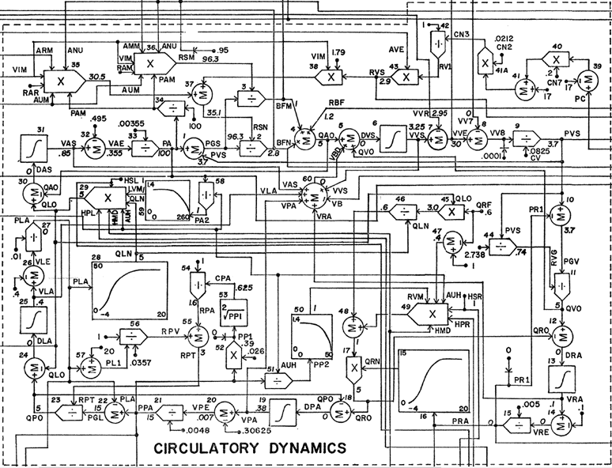
G72 circulation – the schematics

Slide 18
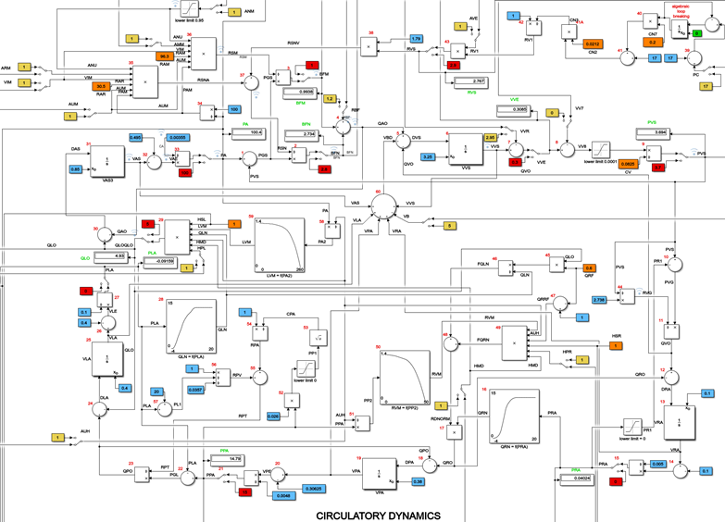
G72 circulation – Simulink

Slide 19
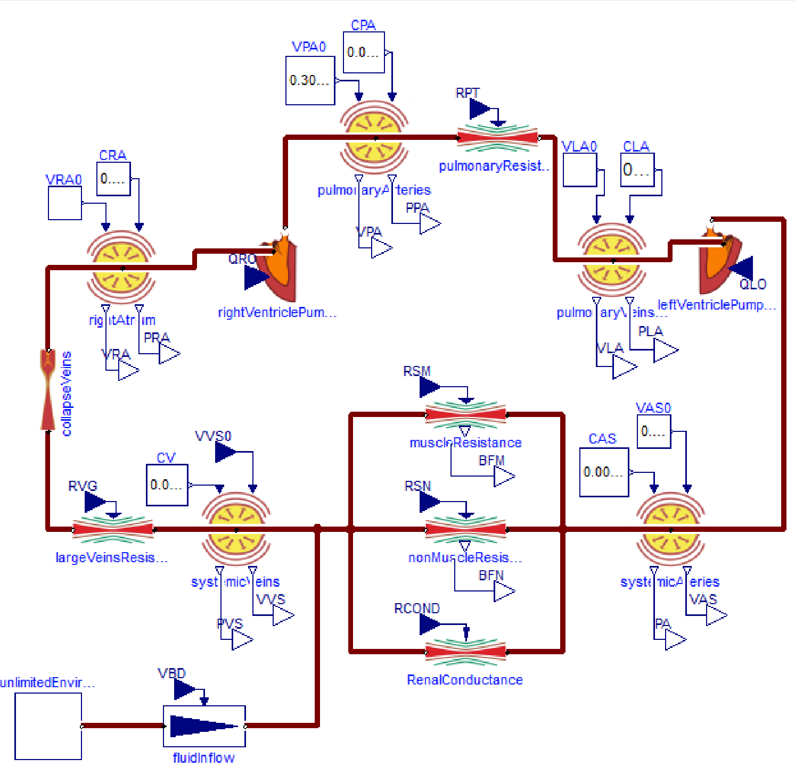
G72 circulation - Modelica

Slide 20
Modelica unifies all advantages
open language, free tools
equation-based
visual, understandable model design
includes documentation
powerful solvers
tool development funded by rich industries

Slide 21
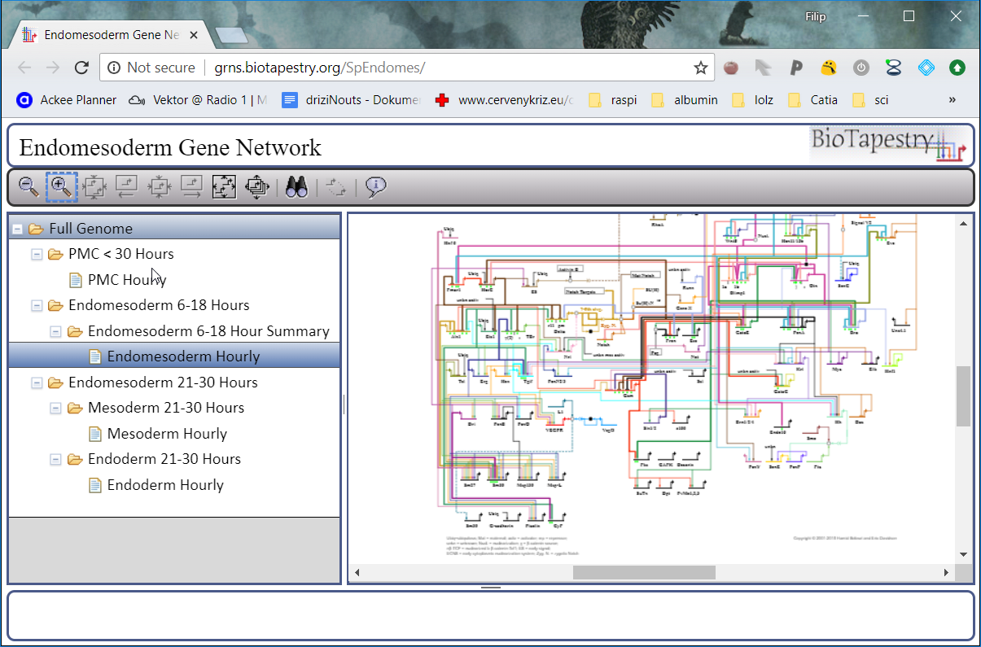
Still, two drawbacks
web-based presentation
such as BioTapestry
specific libraries, model repositories
such as CellML or JSim repository

Slide 22
1. Bodylight.js
FMU-based toolchain for web-simulator development
pure client-side application
model is in binary (webassembly)
FMU 2.0 co-simulation, incl. sources
(Only Dymola at the moment, ticket #4273 in OM)
emscripten JavaScript translation + model controls + graphs + animation components

Slide 23
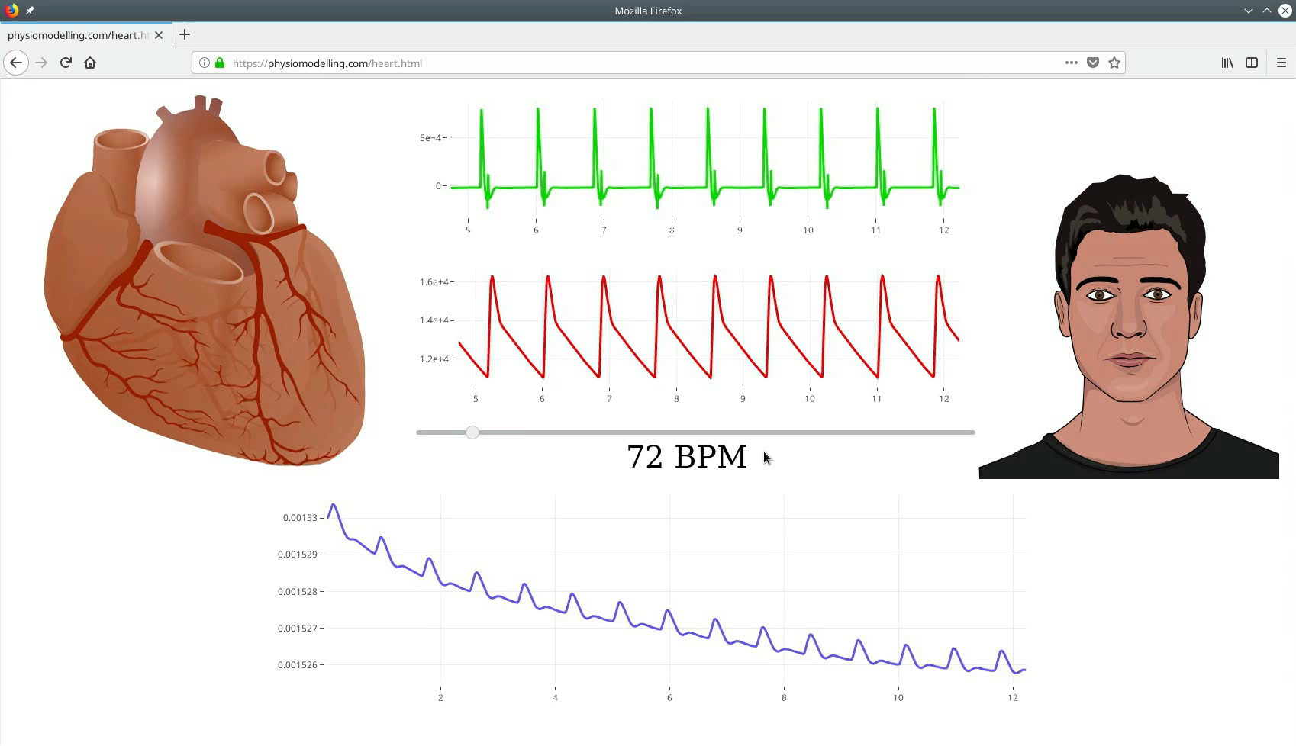
1. Bodylight.js
https://physiomodelling.com/circulation/

Slide 24
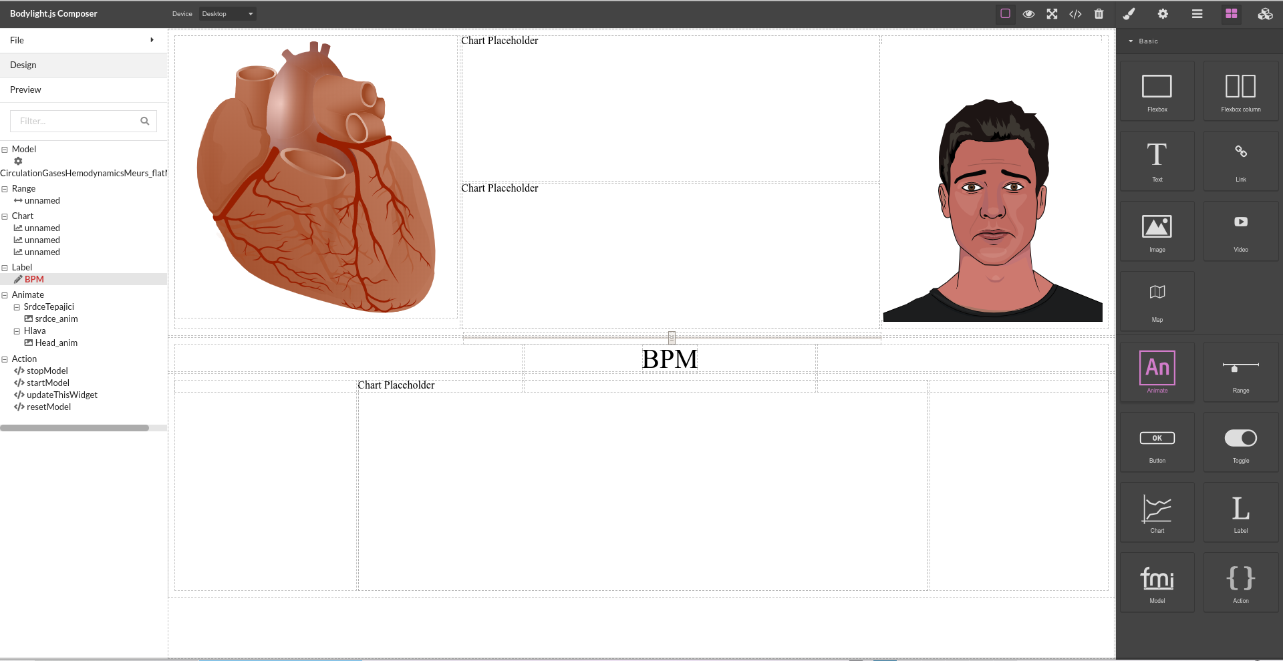
Bodylight.js-composer

Slide 25
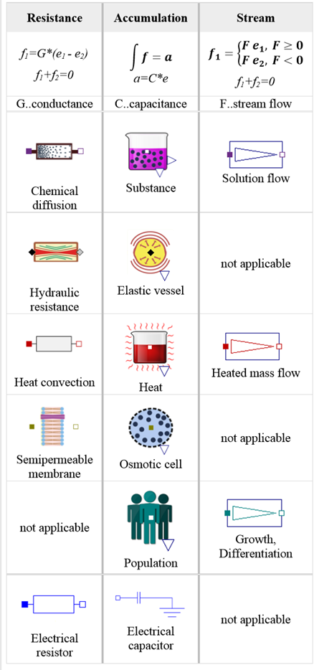
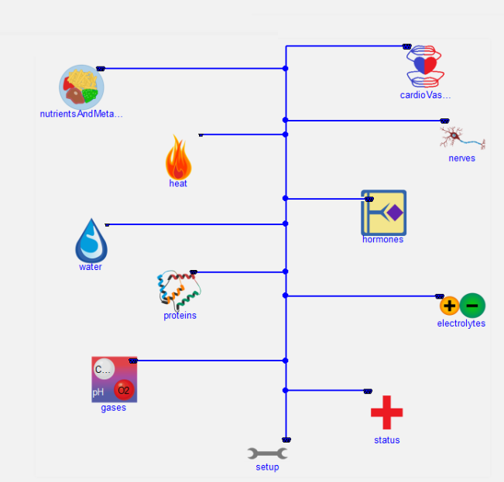
2. Physiolibrary
proved on Physiomodel, our Modelica reimplementation of the largest physiological model, the Hummod

Slide 26
2. Community is an important factor
feedback ensures further innovation
open scientific development
+
business opportunities and financing
Medical education, simulators
Pharmacology
R&D

Slide 27
Thus..
following the example of the Open Source Modelica Consortium ...
Physiomodeling Open Source Consortium ?
www.PhysioModelling.com

